Slide 1
Bringing a Rideshare Program to an Area Near You Lifesavers Conference, April 2018
November 2018 Prevention Quarterly Meeting
National Conference Highlights Workshop
Crystal Gordon

Slide 15
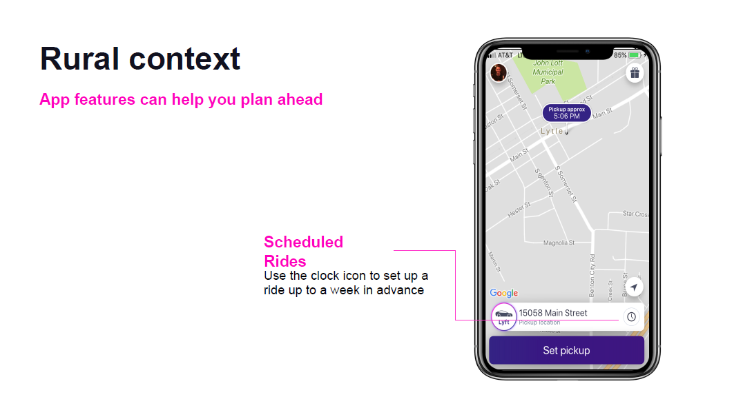

Slide 16
